Slide 1
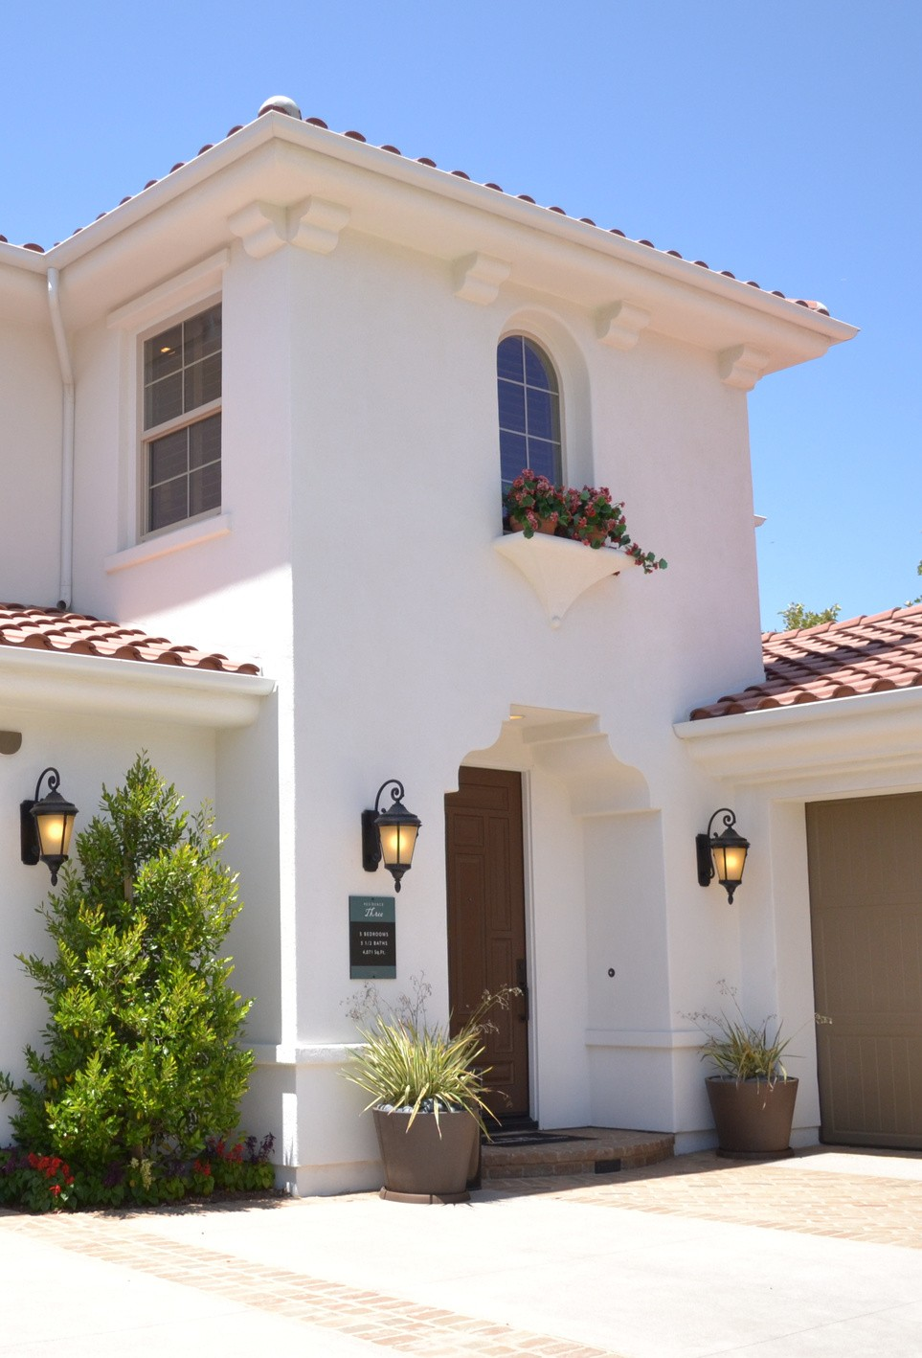
House Sales in King County Regression
Seattle: May 2014-May 2015

Slide 2
TEAM MEMBERS
ML-GROUP 15
01
SAURAV LABADE
02
ISHU GUPTA
03
BUSHRA DOSANI
04
RAJESH KUMAR SAHU

Slide 3
AGENDA
INTRODUCTION
5-STEP PLAN
INSIGHTS
MODEL COMPARISON
APP DEVELOPMENT

Slide 4

INTRODUCTION
Regression models are used to predict the price of a house in seatatle based on the data from May 2014 and 2015
Regression

Slide 5
AIM
To make our evaluations based on every basic parameter that is considered while determining price
01
5-Step Plan
importing Libraries
pandas,numpy,sklearn, seaborn,matplotlib
02
Data Cleaning
Null values,noise and outliers were removed.
03
Linear Regression,Random Forest Regressor,XGBoost,Polynomia Refression(degree 2,3)l
04
MODELS
05
Web App
Pycharm:index.html & main.py

Slide 6

Insights
UNIVARIATE ANALYSIS
BIVARIATE ANALYSIS CHISQUARE ANALYSIS MULTICOLLINEARITY

Slide 7
UNIVARIATE ANALYSIS
Most Properties sold are of near 1 million Prices in Seattle

Slide 8
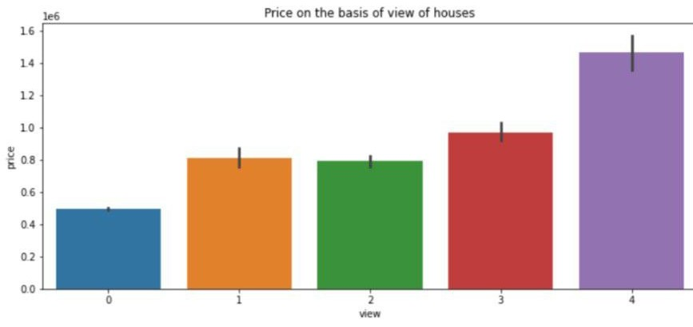
PRICE VS VIEW
THE PROPERTY PRICE IS DIRECTLY RELATED TO THE VIEW IN SEATTLE

Slide 9
CHI SQUARE ANALYSIS
View- Waterfront
Condition- grade
7575.56
2225.62

Slide 10
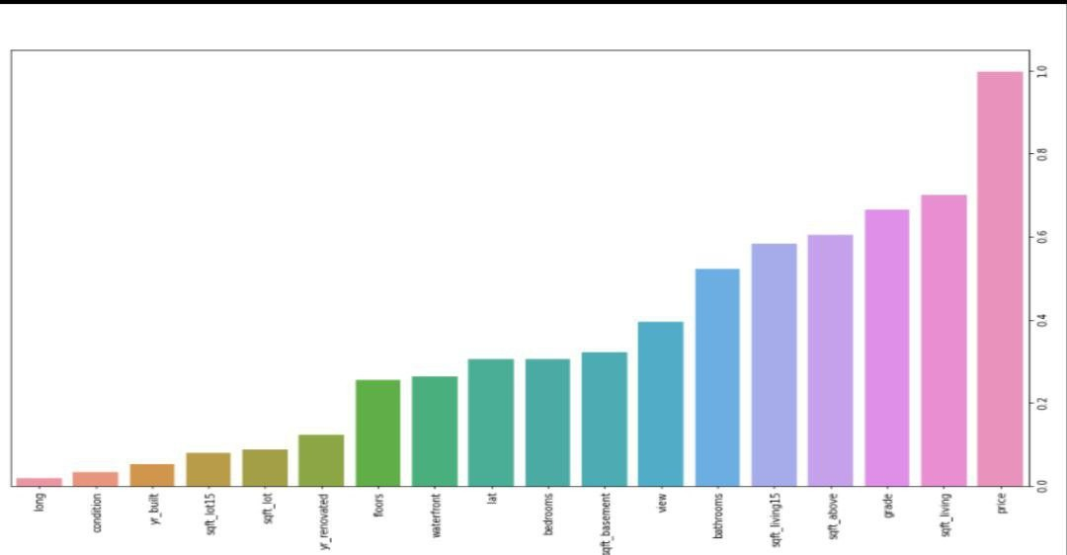
MULTICOLLINEARITY
sqft_above,sqft_ba sement and sqft_living shows some level of multicollinearity..B ut we can't drop them as the are highly correlated with the Price.

Slide 11
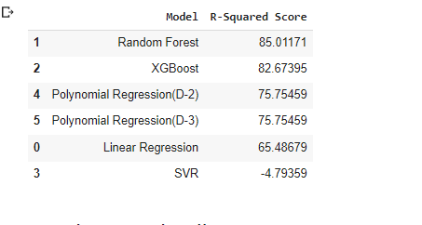
MODEL COMPARISON
RANDOM FOREST
XGBOOST
LINEAR REGRESSION
SVR
POLYNOMIIAL REGRESSION
Random Forest Regressor:Highest R2_Score

Slide 12
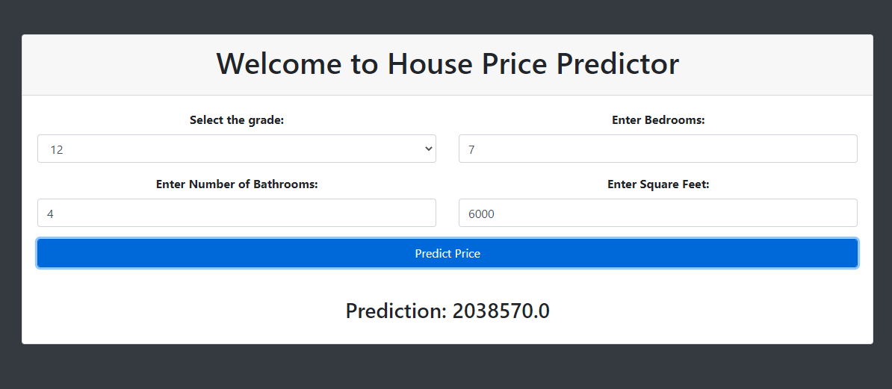
House Price Predictor
Random Forest Regressor Model was used to create a webapp which can predict the House price based on Parameters:
grade,sqft,bedrooms and bathrooms in Seattle.

Slide 13
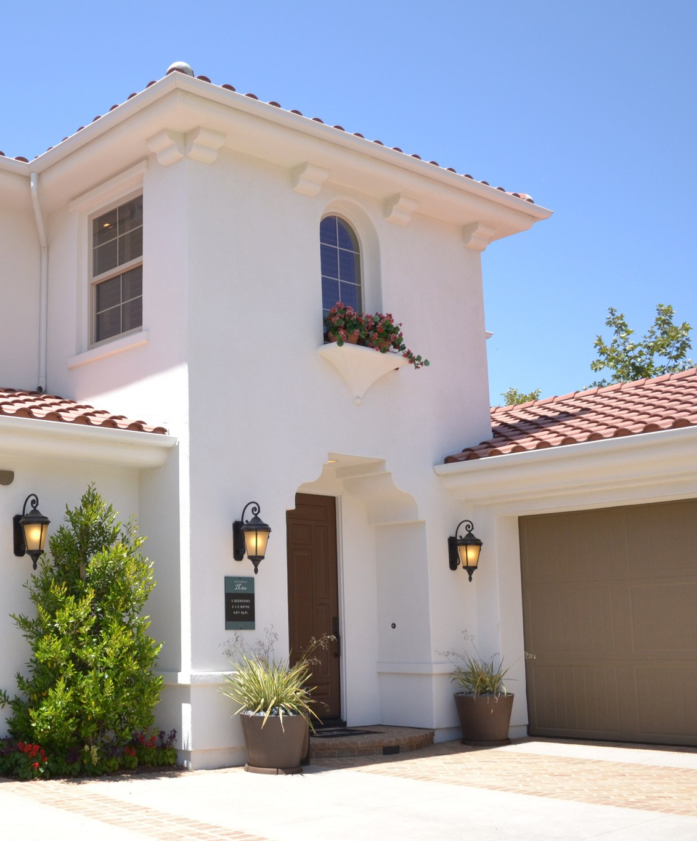
Thanks !

